Slide 1



School of Computing and Information Technology, Eastern International University (EIU) - Vietnam

Slide 2



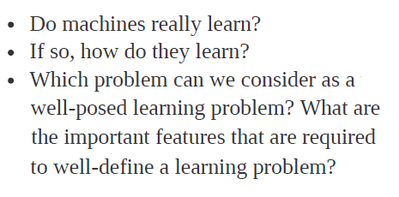
School of Computing and Information Technology, Eastern International University (EIU) - Vietnam

Slide 3

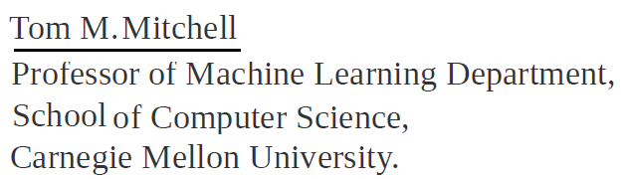


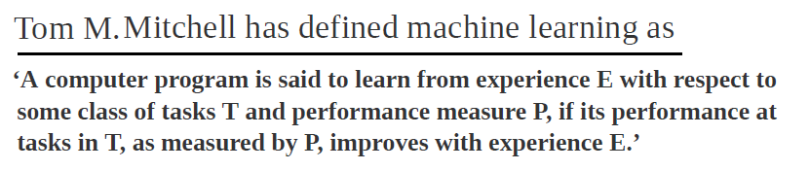
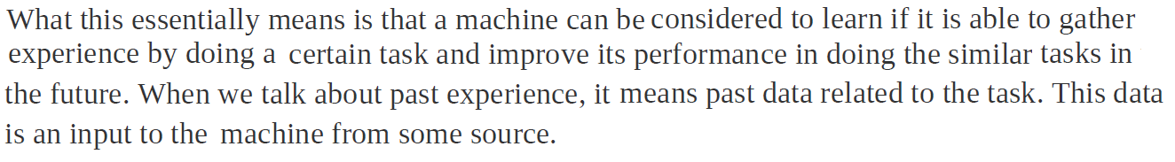
School of Computing and Information Technology, Eastern International University (EIU) - Vietnam

Slide 4
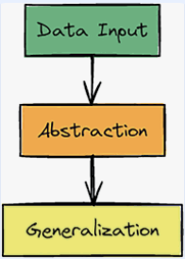
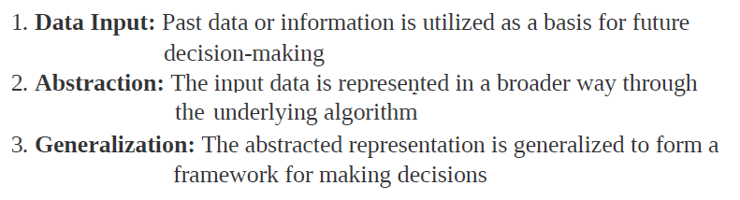
School of Computing and Information Technology, Eastern International University (EIU) - Vietnam

Slide 5
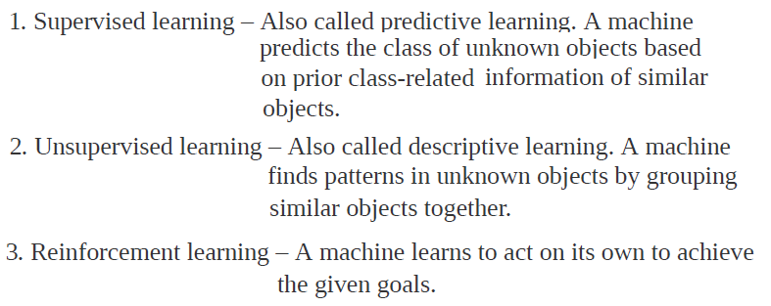

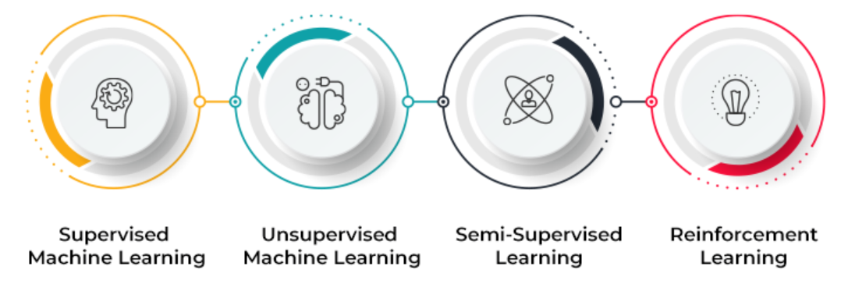

School of Computing and Information Technology, Eastern International University (EIU) - Vietnam

Slide 6

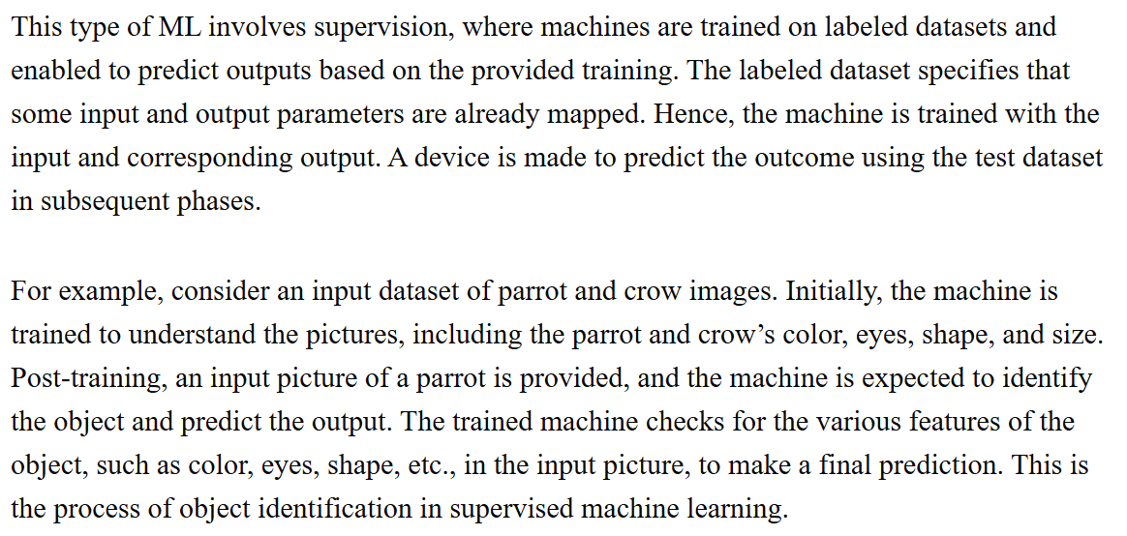
School of Computing and Information Technology, Eastern International University (EIU) - Vietnam

Slide 7
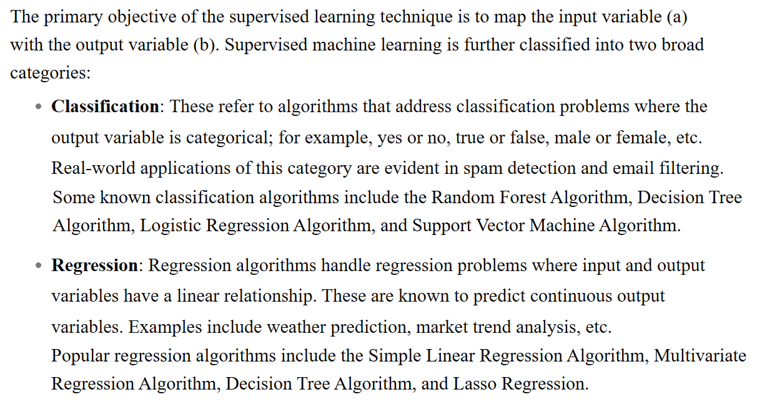

School of Computing and Information Technology, Eastern International University (EIU) - Vietnam

Slide 8
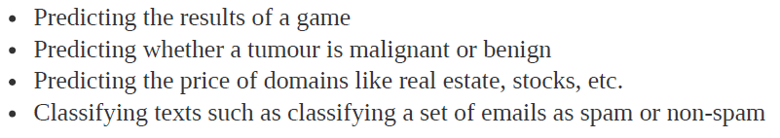
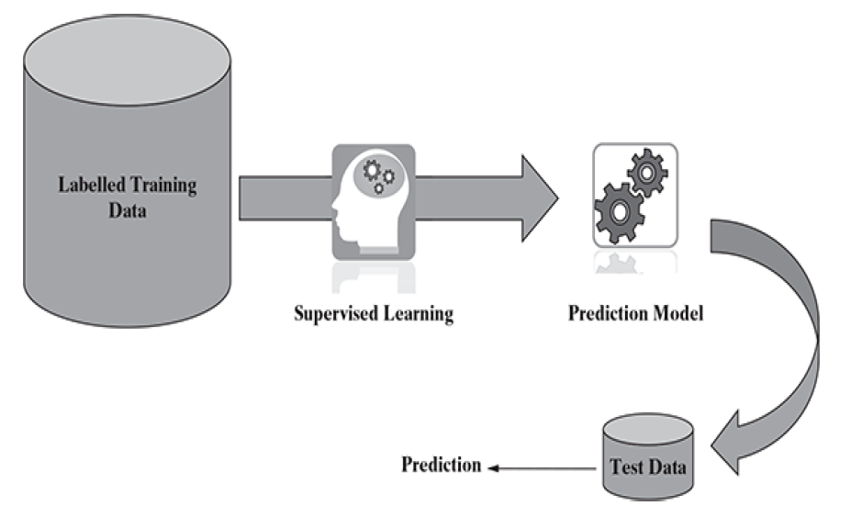

School of Computing and Information Technology, Eastern International University (EIU) - Vietnam

Slide 9
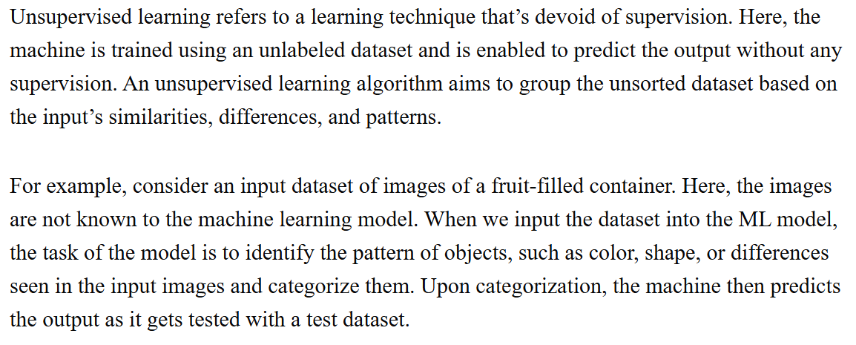
School of Computing and Information Technology, Eastern International University (EIU) - Vietnam

Slide 10
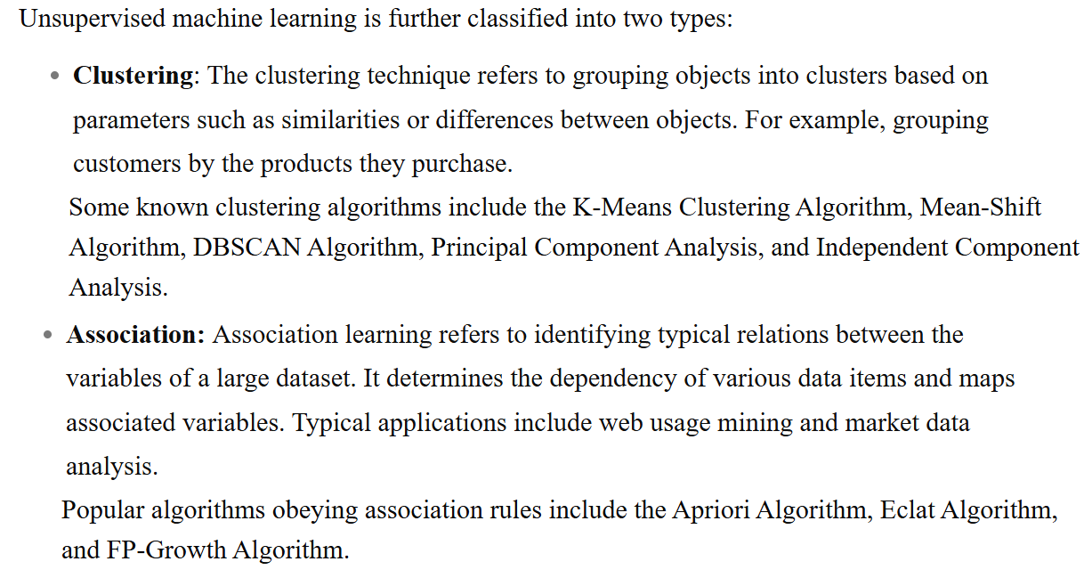

School of Computing and Information Technology, Eastern International University (EIU) - Vietnam

Slide 11
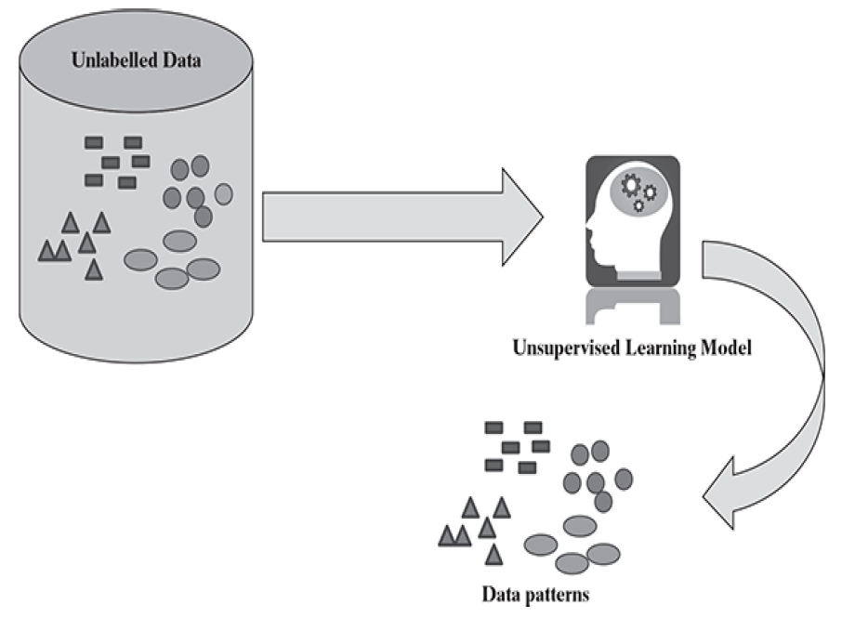

School of Computing and Information Technology, Eastern International University (EIU) - Vietnam

Slide 12

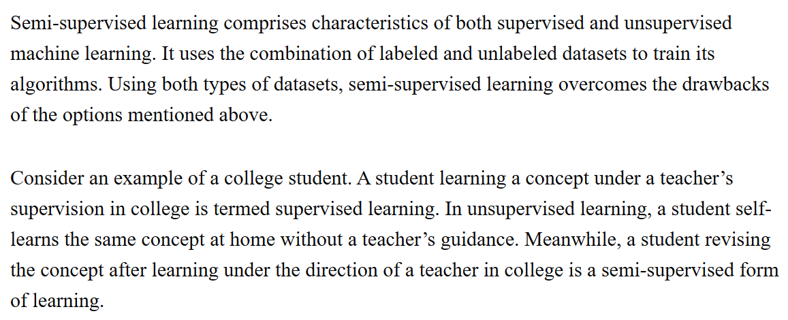

School of Computing and Information Technology, Eastern International University (EIU) - Vietnam

Slide 13

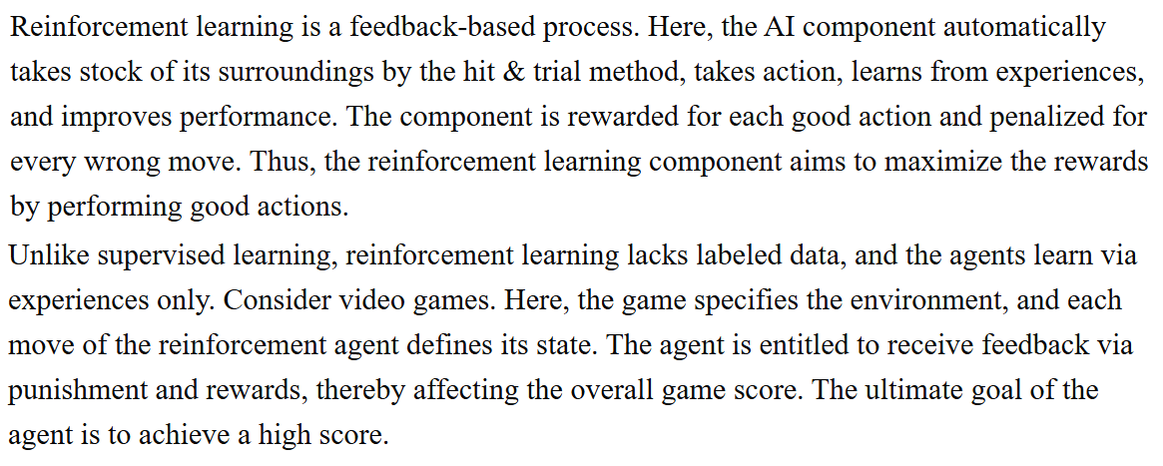
School of Computing and Information Technology, Eastern International University (EIU) - Vietnam

Slide 14
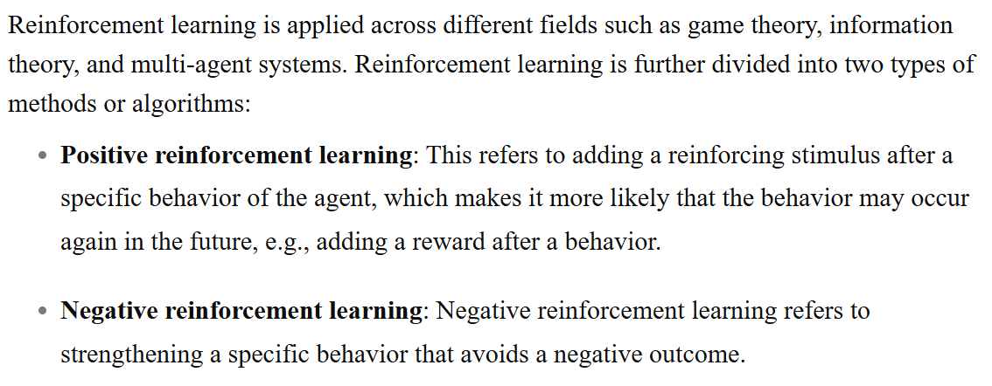

School of Computing and Information Technology, Eastern International University (EIU) - Vietnam

Slide 15
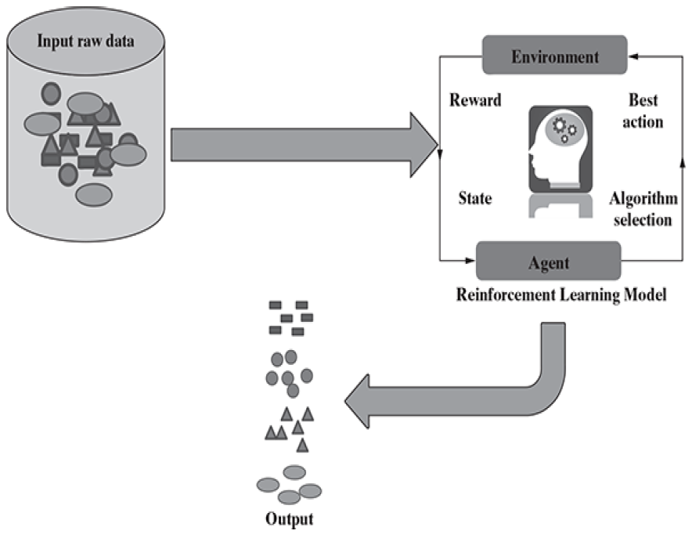
School of Computing and Information Technology, Eastern International University (EIU) - Vietnam

Slide 16
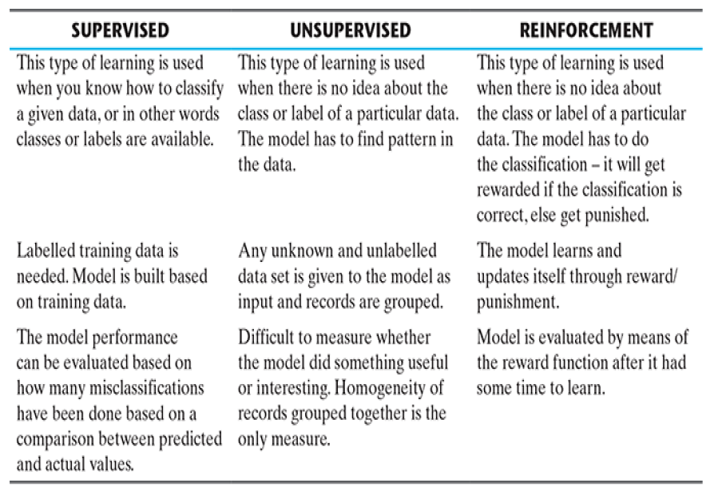
School of Computing and Information Technology, Eastern International University (EIU) - Vietnam

Slide 17

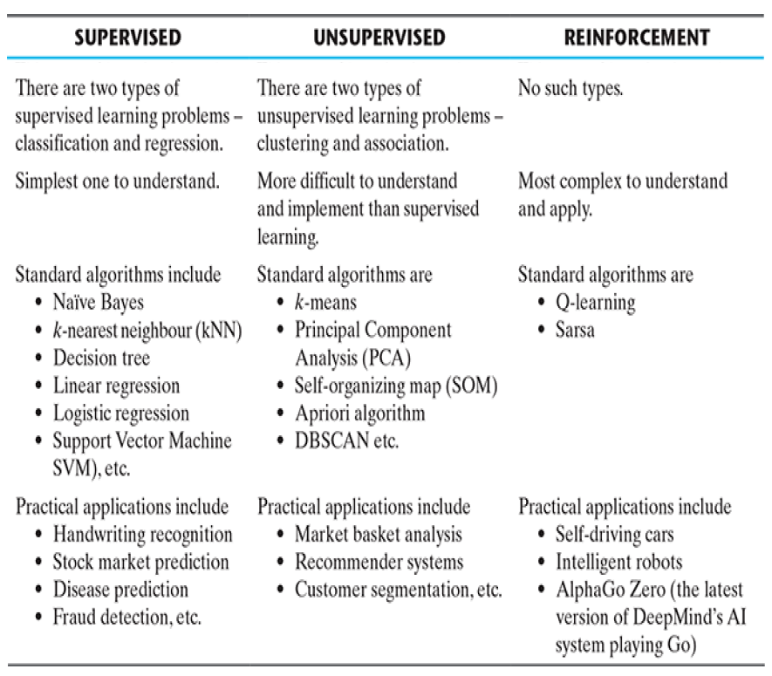

Slide 18
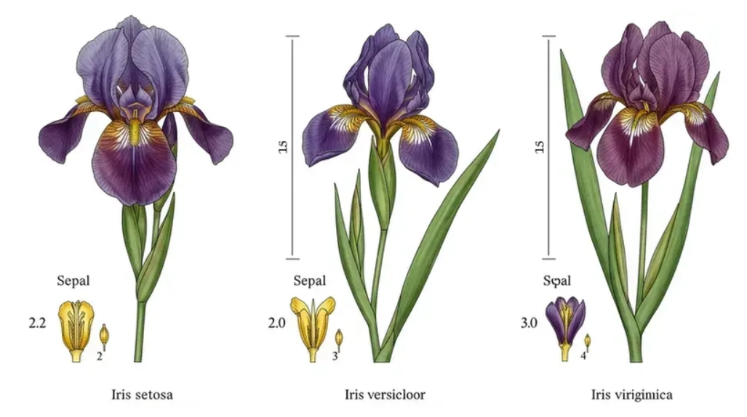

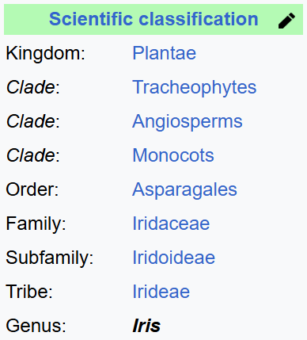
https://dev.to/vaib/hands-on-ai-for-beginners-classifying-iris-flowers-in-python-2j4h
School of Computing and Information Technology, Eastern International University (EIU) - Vietnam

Slide 19
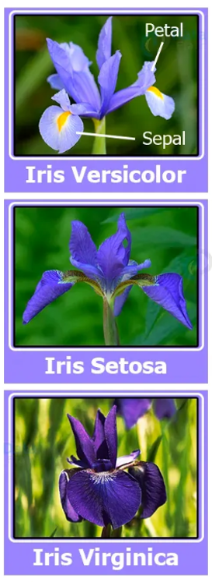
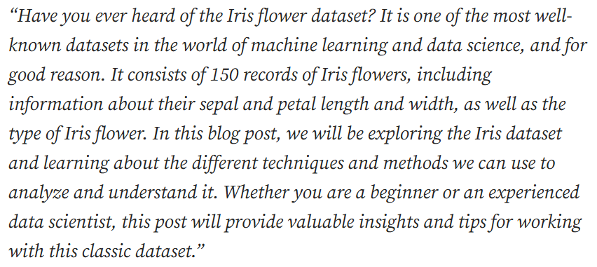


https://eminebozkus.medium.com/exploring-the-iris-flower-dataset-4e000bcc266c
School of Computing and Information Technology, Eastern International University (EIU) - Vietnam

Slide 20

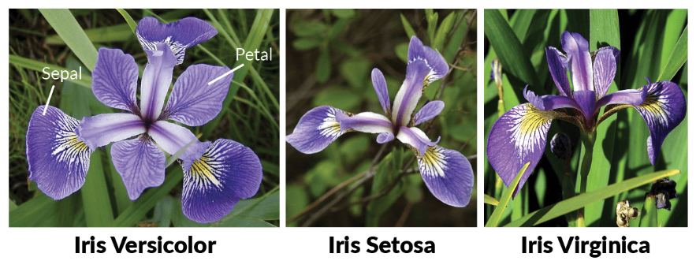

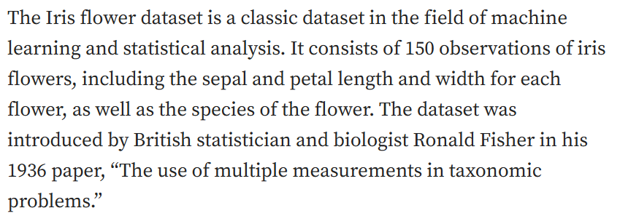
School of Computing and Information Technology, Eastern International University (EIU) - Vietnam

Slide 21
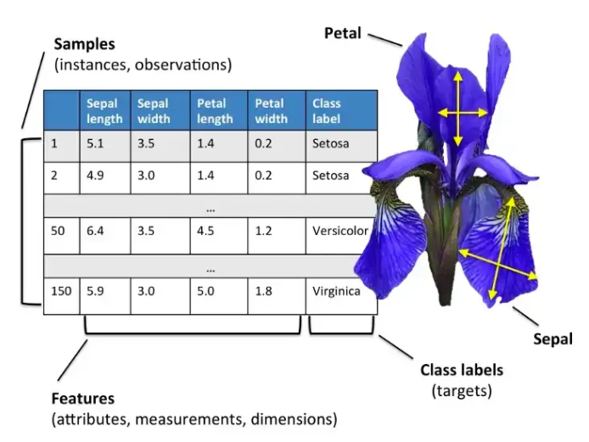
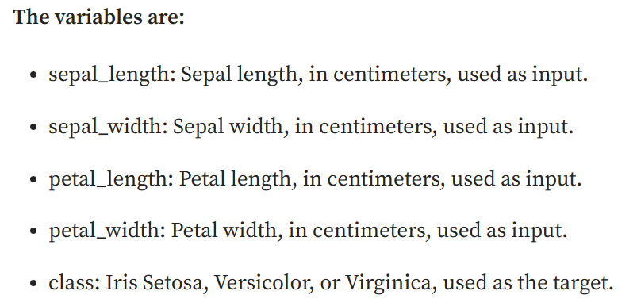
School of Computing and Information Technology, Eastern International University (EIU) - Vietnam

Slide 22

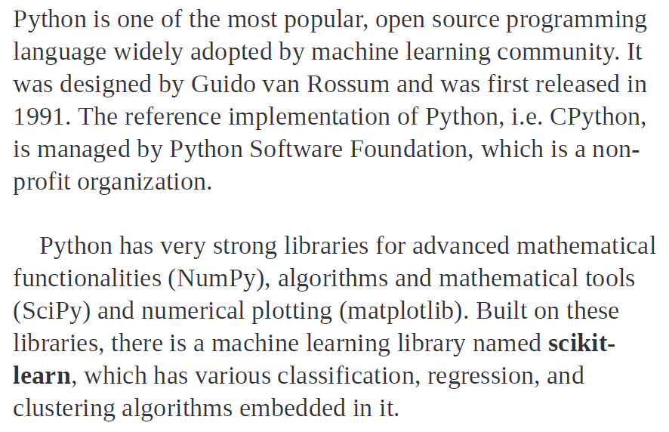
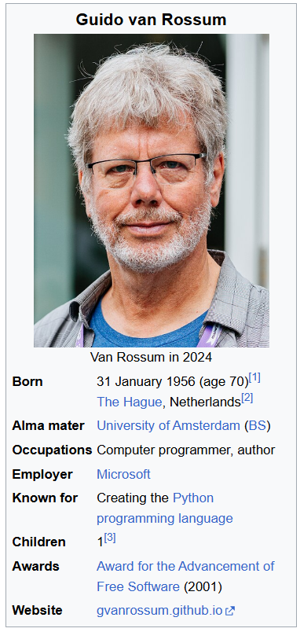

School of Computing and Information Technology, Eastern International University (EIU) - Vietnam

Slide 23

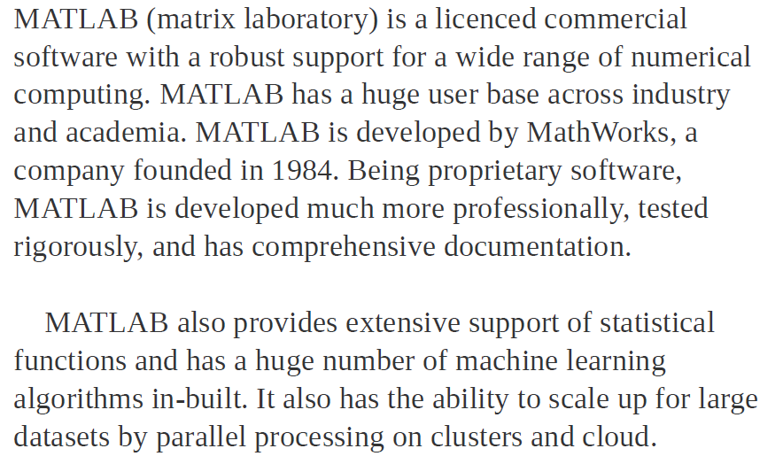


School of Computing and Information Technology, Eastern International University (EIU) - Vietnam

